Slide 1
HOME – Housing Strategies That Work
2023 NCDA Winter Conference
January 25, 2023

Slide 2
Speakers
Kevin Howard
Director of Housing & Neighborhood Programs
City of Little Rock, AR
Darwin Wade
Area Redevelopment Manager
Housing & Neighborhood Revitalization
City of Dallas, TX

Slide 3
The City of Little Rock - Demographics
Little Rock
The capital city of Arkansas is also the state’s largest municipality, with over 202,000 people calling it home. The City is divided into 7 Wards.
Demographics of the City of Little Rock:
Racial Make up – White 45.5%, African American 41.9%, Asian 3.1%, Hispanic 7.5%
Housing – Owner Occupied Housing Rate 54%, Median Value -$200,000
Rental Units Rate 46% Average Rent - $900 per month
Median Household Income - $53,630
Persons in Poverty – 15.3%
Land Square Miles – 120

Slide 4
Little Rock Historical Uses of Funds
HOME INVESTMENT PARTNERSHIP PROGRAM (HOME)
NEW CONSTRUCTION – SINGLE FAMILY
SUBSTANTIAL AND MODERATE REHABILITATION – OWNER OCCUPIED
FIRST-TIME HOMEBUYER ASSISTANCE
CHDO SET-ASIDE (15%)
HOME ADMINISTRATION (10%)
CHDO OPERATING (5%)

Slide 5
Little Rock Current Uses of Funds -Strategies
HOME INVESTMENT PARTNERSHIP PROGRAM (HOME)
NEW CONSTRUCTION – SINGLE FAMILY
ACQUISITION/REHAB – SINGLE FAMILY
DOWN PAYMENT ASSISTANCE PROGRAM (DPA)
CHDO SET-ASIDE (15%)
HOME ADMINISTRATION (10%)
TENANT BASE RENTAL ASSISTANCE (TBRA)

Slide 6
New Construction – Single Family Unit
Projects MUST
Meet all applicable State and local codes, ordinances, and zoning requirements
Mitigate the impact of potential disasters (Environmental Review must be completed prior to any HUD funds being disbursed
Written Cost estimates, construction contracts and documents (Ensure cost are reasonable). The City uses Housing Developer Pro software.
Complete Housing Inspection
Contractor MUST
Obtain a Bid Bond
Obtain a Payment & Performance Bond (full amount of contract)
Must not be disbarred from receiving federal awards ( Check SAM.gov )
Have State Business License

Slide 7
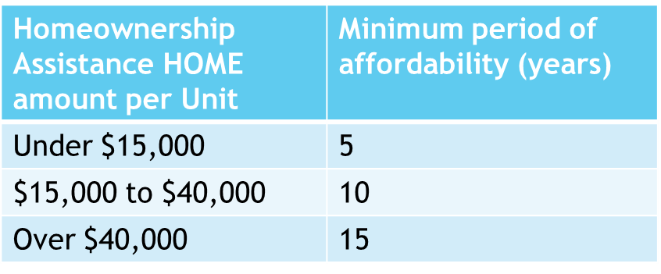
New Construction – Single Family Unit
Qualifications
Must not exceed FY 22 Maximum HOME Purchase Price set by HUD. (Central Arkansas $251,000 for 1 unit)
Unit must be in the PJ’s jurisdiction
Homebuyer must not exceed income limits
Must be principal residence of the homebuyer
Must establish the resale or recapture requirements in accordance with ConPlan
Must meet affordability period
Best Practice: The City of LR uses the method that reduces the HOME investment amount to be recaptured on a prorated basis for the time the homeowner has owned and occupied the housing measured against the required affordability period.

Slide 8
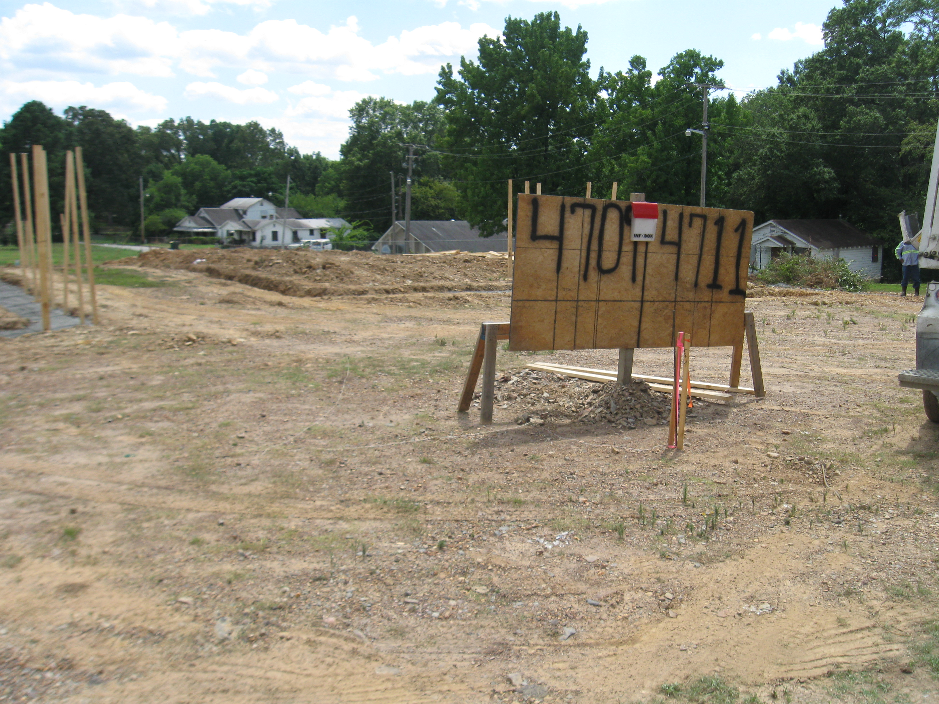
New Construction – Single Family Unit
LR Homebuyers program the homebuyer will apply for a traditional mortgage loan. The City will provide a Homebuyer subsidy in the amount up $20,000 for closing cost, prepaid items,& Government fees. The Homebuyer must received the maximum loan amount and meet the Program Income guidelines of 80% AMI. The City will underwrite all loans prior to closing and inspect units.

Slide 9
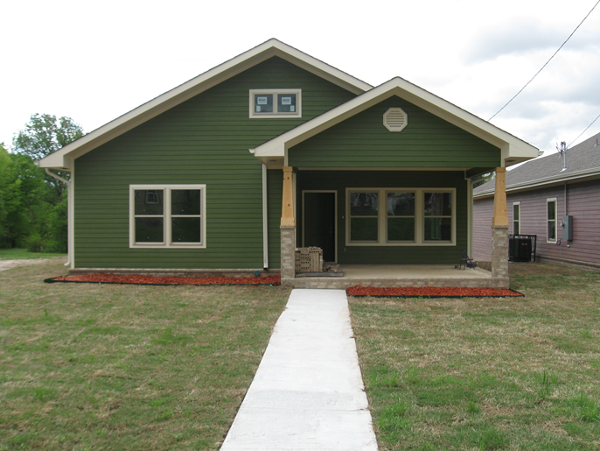
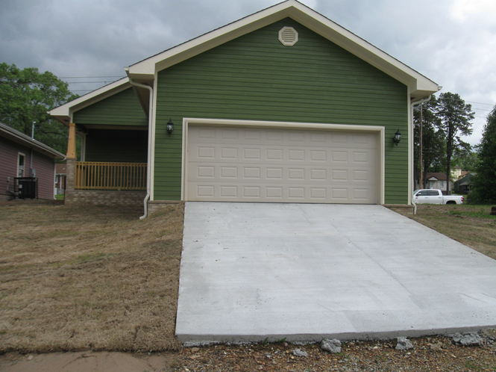
New Construction – Single Family Unit
Little Rock Homebuyers Program
In an effort to maximize the revitalization efforts, the City of Little Rock developed a single family home located at 4709 Charles Bussey. This home was listed and sold to an eligible low-to-moderate income family for $150,000. The program income after construction costs and subsidies was $127,000

Slide 10
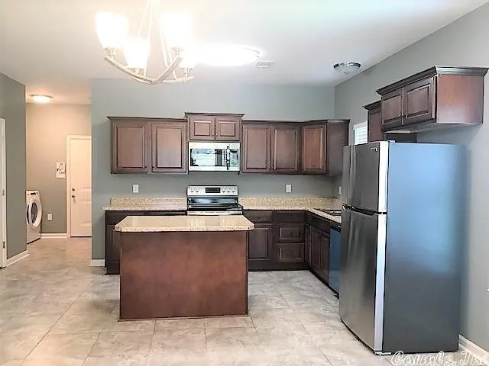
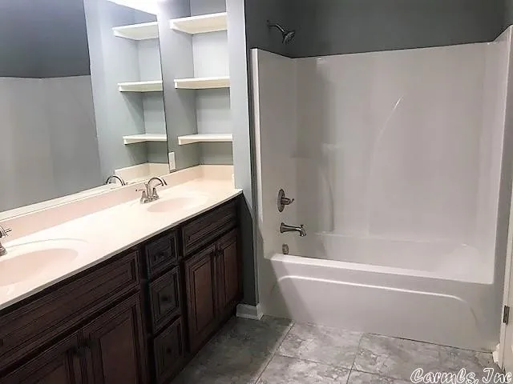
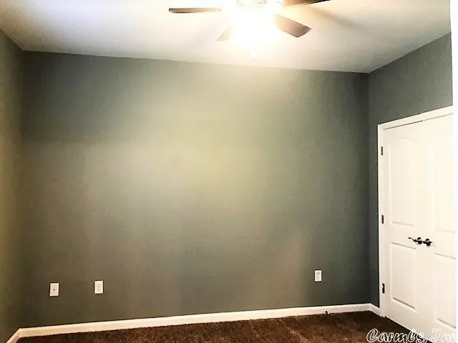
New Construction – Single Family Unit
4709 Charles Bussey 1,486 sqft 3 bedroom / 2 bathroom

Slide 11
New Construction – Single Family Units
CHDO’S
Community Housing Development Organizations
Can be reserve not less than 15% of the HOME allocation
To be the “developer” the community development housing organization must arrange financing of the project and be in sole charge of construction.
Must have a written agreement with the CHDO (must include sales price and if the proceeds from the sale will be returned to the PJ or kept by the CHDO)
CHDO can’t receive HOME funding for any fiscal year in the amount that provides 50% or $50,000 (whichever is greater) of the CHDO’S total operating costs.
EX: CHDO Operating cost is $200,000. Can’t exceed $100,000 in HOME funding
Refer to 24 CFR 92.251 for a complete list of regulations
*The 24-month commitment requirement for (CHDO) and regular (HOME) funds have been suspended through December 31, 2023.

Slide 12
Little Rock Certified CHDO’S
Better Community Development (BCD)
University District Development Corporation (UDDC)
In Affordable Housing (IAH)

Slide 13
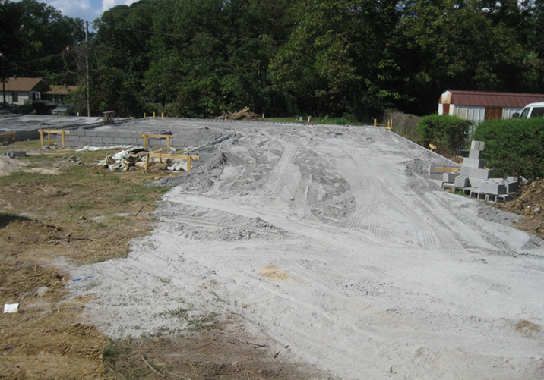
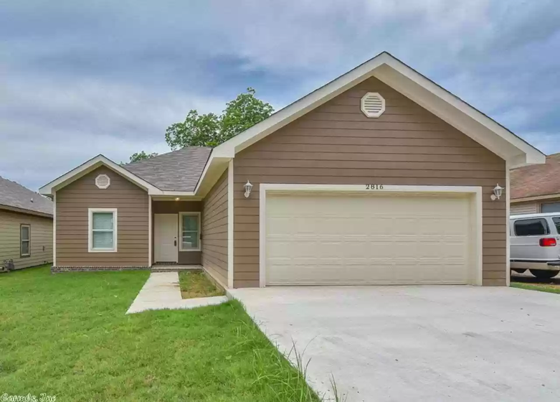
New Construction Single Family Unit
BEFORE
AFTER
The City of Little Rock partnered with one of our CHDO’s University District Development Corporation (UDDC) to develop a single family home located at 2618 Adams Street, Little Rock, AR 72204
This is a 1,400 sqft home /3 bedroom, 2 bathroom

Slide 14
Down Payment Assistance
The City of Little Rock has allocated funds to assist low and moderate-income first time homebuyers
The total of the down payment assistance from the City of Little Rock may not exceed six (6) percent of the purchase price, not to exceed $6,000.00
Buyer must agree to own/occupy the property for a minimum of five (5) years (Affordability Period)
Must serve as the homebuyers primary place of residence
The loan is forgiven in equal monthly installments over a 60-month period
Unit must pass inspection prior to approval of the assistance

Slide 15
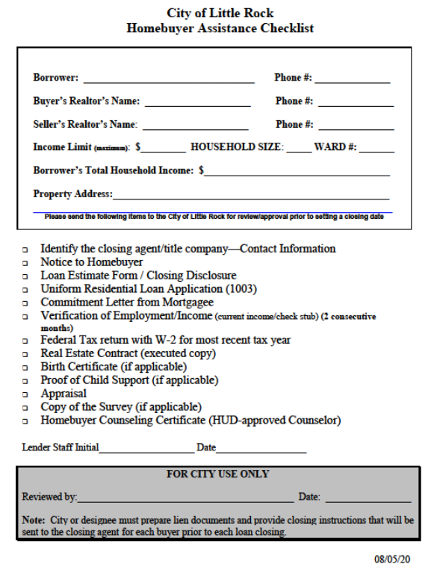
Down Payment Assistance – Checklist
Provide the closing agent/title company – Contact Information (Phone#)
Notice to Homebuyer
Loan Estimate Form/Closing Disclosure
Uniform Residential Loan Application (1003)
Commitment Letter from Mortgagee
Verification of Employment/Income(current income/check stub) 2 consecutive months
Federal Tax returns with W-2’s for last two years (if applicable)
Real Estate Contract (executed copy)
Birth Certificate (if applicable)
Proof of Child support (if applicable)
Appraisal
Homebuyer Counseling Certificate -HUD-approved

Slide 16
Down Payment Assistance
Frequent Mistakes
Not providing a signed 1003 (loan application)
Setting a closing without City’s approval
Not ensuring Title Company is aware of City’s Guidelines
Not providing most recent 2 consecutive months of income
Communication is key

Slide 17
Tenant Based Rental Assistance (TBRA)
Eligible Activities & Costs
Rental assistance to help pay the cost of monthly rent and utility costs for up to 24 months.
The amount of HOME funds provided for a security deposit may not exceed the equivalent of two month’s rent for the unit
Utility deposit assistance must be in conjunction with rental assistance and security deposit assistance.
Eligible administrative costs include reasonable costs of overall program management, coordination, monitoring, and evaluation.

Slide 18
Tenant Based Rental Assistance (TBRA)
Ineligible Activities & Costs
To make commitments to specific owners for specific projects. Tenants must be free to use the assistance in any eligible unit.
To prevent displacement of or provide relocation assistance to tenants as a result of activities other than the HOME Program.
To provide TBRA to homeless persons for overnight or temporary shelter.
To provide assistance for more than 24 months
To duplicate existing rental assistance programs that already reduce the tenant’s rent payment to 30 percent of income.
To provide assistance outside of our City limits

Slide 19
Tenant Based Rental Assistance (TBRA)
Quick Tips
Programs must have a written selection policy
Unit must comply with all Housing Quality Standards
Unit must be Rent Reasonable
Unit must not exceed HUD’s maximum rents for the HOME Program(City of Little Rock uses FMR)
Program must provide a rental assistance Contract with the lessee and/or owner of the unit
Household annual income must not exceed 80% of the area median income
Up to 100% subsidy for housing costs may be provided
Unit must pass HQS inspection –Must inspect annually if still under contract

Slide 20
Questions???
Kevin Howard
City of Little Rock
500 W. Markham, Suite 120W
Little Rock, AR 72201
501-371-6825

